Slide 1
GCMC Workload report
Usage and migration guide
For GCMC’s manager + functions teams (design, production and contents)

Slide 2

GCMC Workload report
Sign-in information
Use “gcmc” for both username and password. Otherwise app stays in view-only mode.
Data is LIVE. Account is all-access, do not share with strangers.

Slide 3
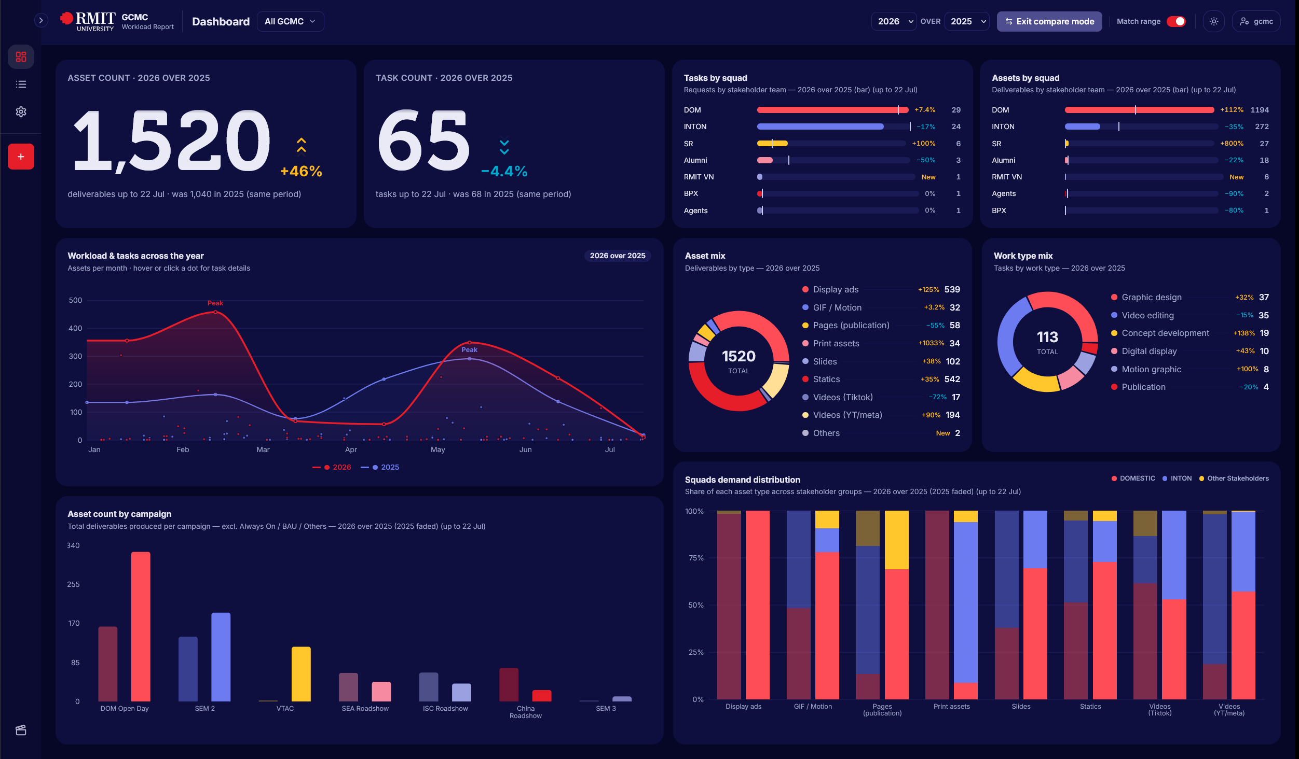
What is it
A shared system of record for GCMC's workload — Vietnam Design, Melbourne Design, Production and Content all log into it.
Every task captures its work types, asset counts and timeline.
The dashboard turns that into live charts — by squad, campaign, asset type, and time of year.
No more chasing a status update — stakeholders see it directly.

Slide 4
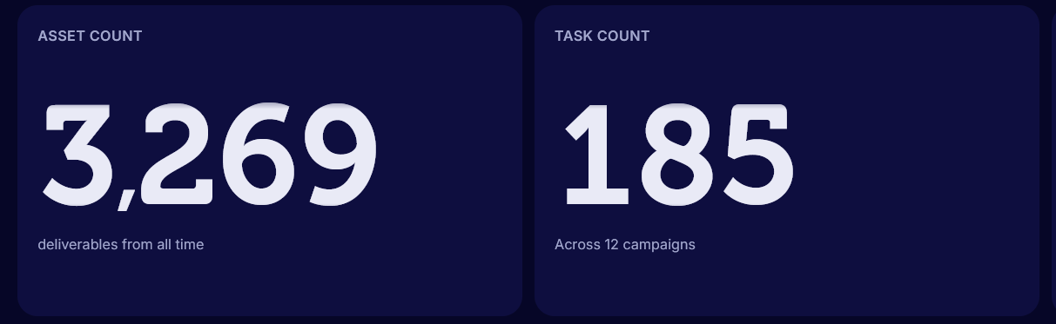
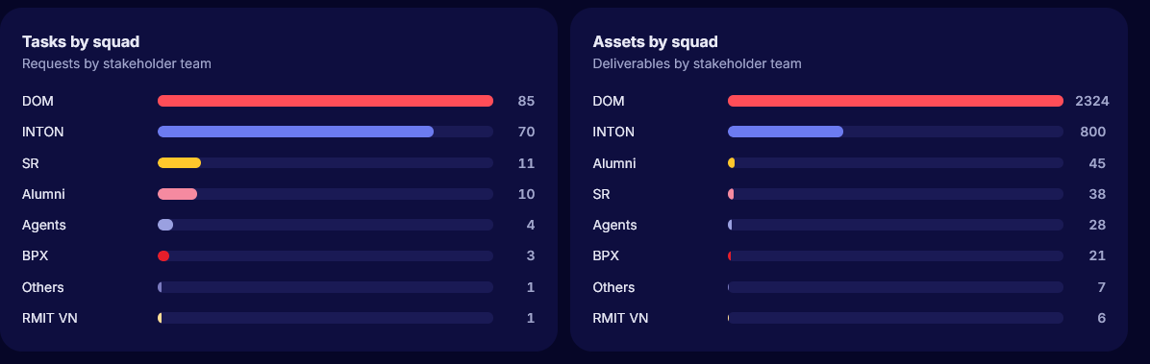
Dashboard
Asset count
Total deliverables produced — every asset, across every task, in the selected period.
Task count
How many tasks that workload came from, and how many campaigns they span.
Tasks by squad
Which stakeholder teams are asking for work — request volume per squad.
Assets by squad
What each squad actually received — deliverable volume, not just request count.

Slide 5
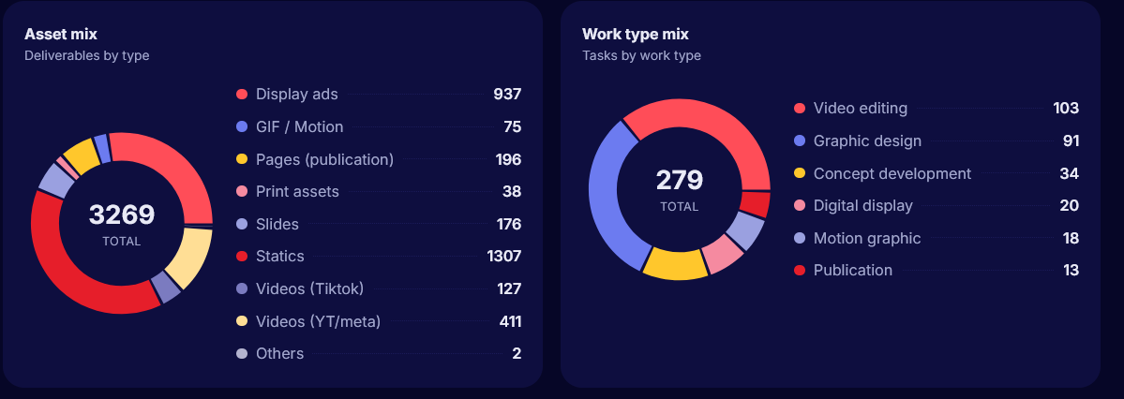
Dashboard
Asset mix
The breakdown of what was produced — statics, display ads, video, print — as a share of the total.
Work type mix
The breakdown of what kind of work it took to get there — editing, design, concepting — not just outputs.

Slide 6
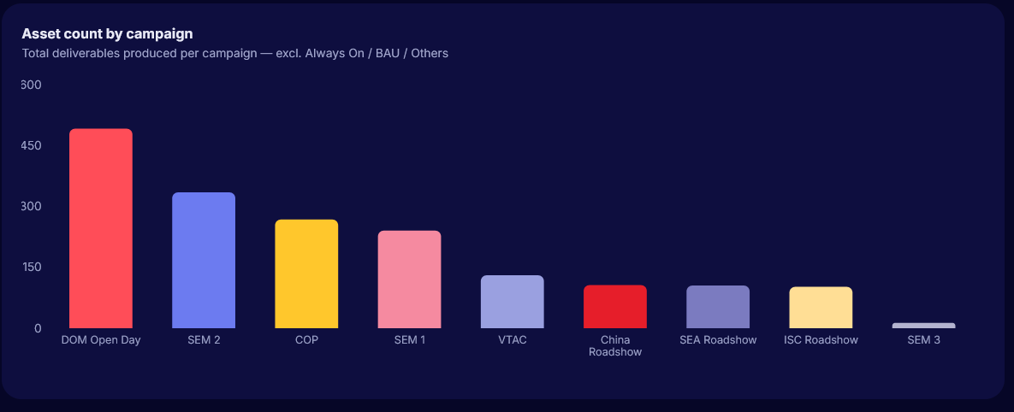
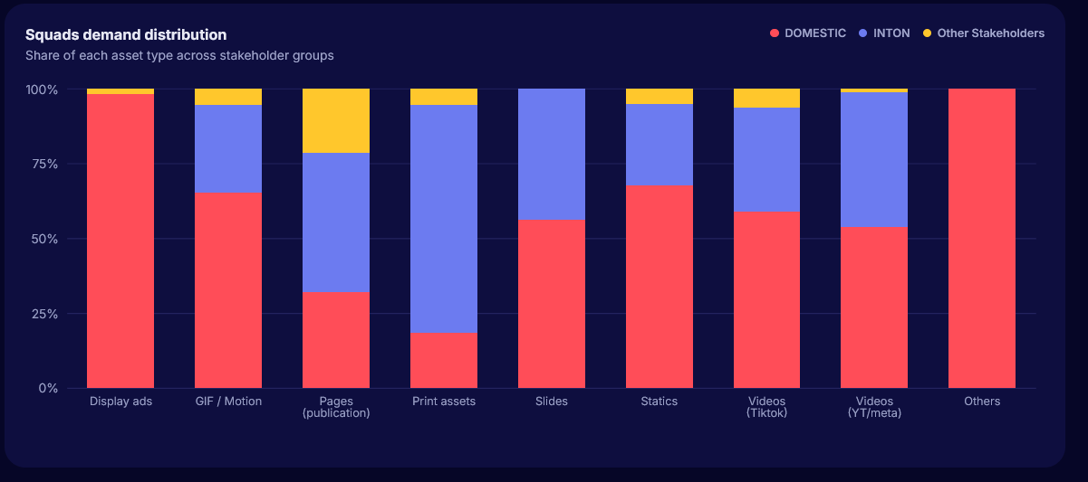
Dashboard
Asset count by campaign
Total deliverables produced per named campaign — Always On, BAU and Others excluded, so it's just the campaign-driven push.
Squads demand distribution
For each asset type, who's asking for it — the split between Domestic, INTON and Other Stakeholders. Shows which deliverables are one squad's core demands.

Slide 7
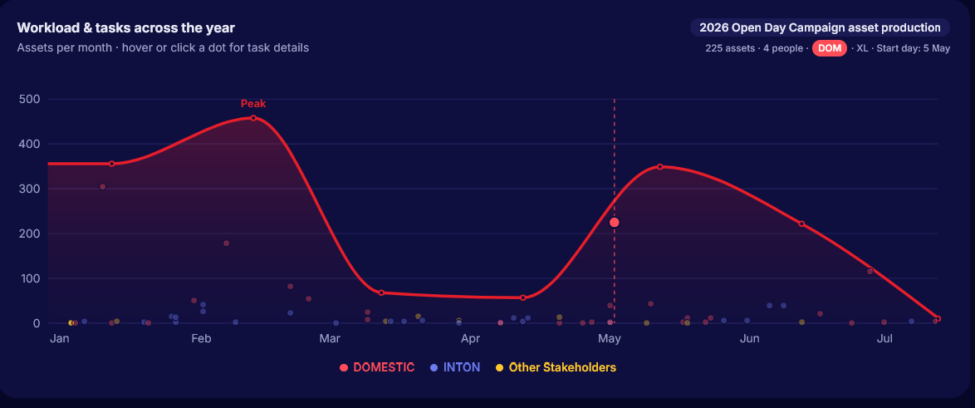
Dashboard
Workload & tasks across the year
The line shows total assets delivered per month. Underneath, every task is plotted as a dot — height shows how big that task was, and dense clusters show busy periods, colour-coded by stakeholder group.
Hover or click a dot to jump into that task's details.

Slide 8
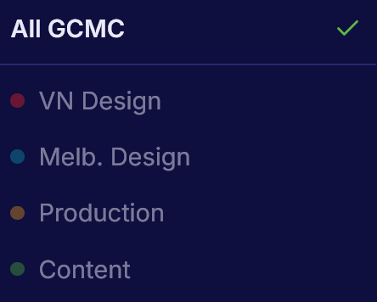
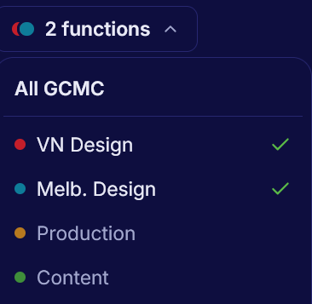
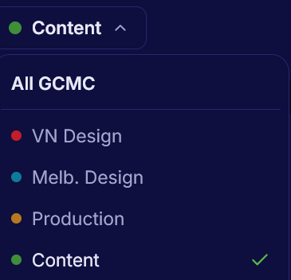
GCMC Combined / standalone dashboard
Every dashboard view can be filtered by function — narrow it down to see one team's numbers on their own, or combine any group of them together.
All GCMC (default) — the combined view across all four functions.
Pick one function (e.g. Content) — a standalone view of just that team's workload.
Pick several (e.g. VN Design + Melbourne Design) — combines just those functions, so related teams can be viewed together without pulling in everyone.

Slide 9

Span selection
Controls the time window every chart on the dashboard reads from.
Total — all tasks ever logged, no date filter.
By year — one year at a time, picked from the dropdown (only years that actually have tasks appear).
By half — narrows further to H1 or H2 of the selected year.
Note: workload was only recorded from 2025 onward — anything before that isn't in the system, so year selection starts there.

Slide 10
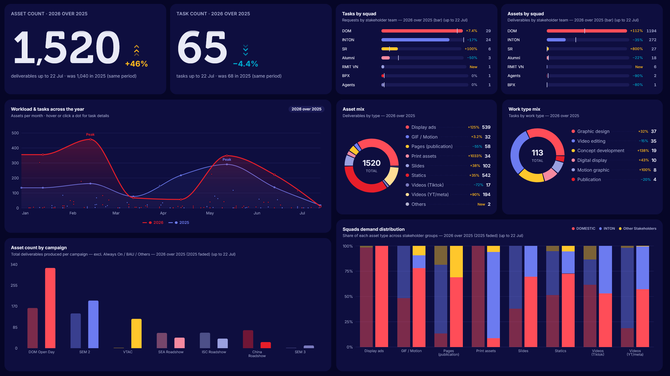
Compare
mode
Turns every panel into a year-over-year view — 2026 against 2025, matched to the same date range (up to today) so the comparison is fair, not skewed by how much of the year has passed.
Big numbers get a % change and a same-period reference ("was 1,040 in 2025").
Bar and list panels (squads, asset mix, work type mix) show a % delta per item, plus "New" for anything that didn't exist last year.
The workload chart overlays both years so you can see exactly where this year is running ahead or behind.
Campaign and squad-distribution charts follow the same solid-vs-faded pattern.

Slide 11
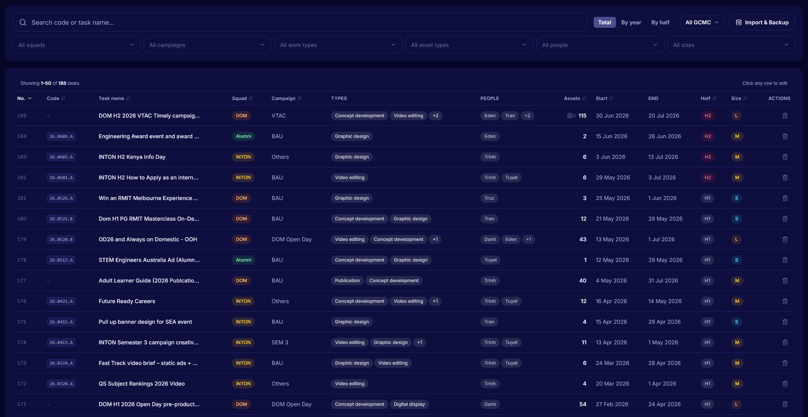
Task List
Every task GCMC has ever logged, in one searchable table — search by code or name, filter by squad, campaign, work type, asset type, person, size or function, and sort any column. Click a row to open and edit it.

Slide 12
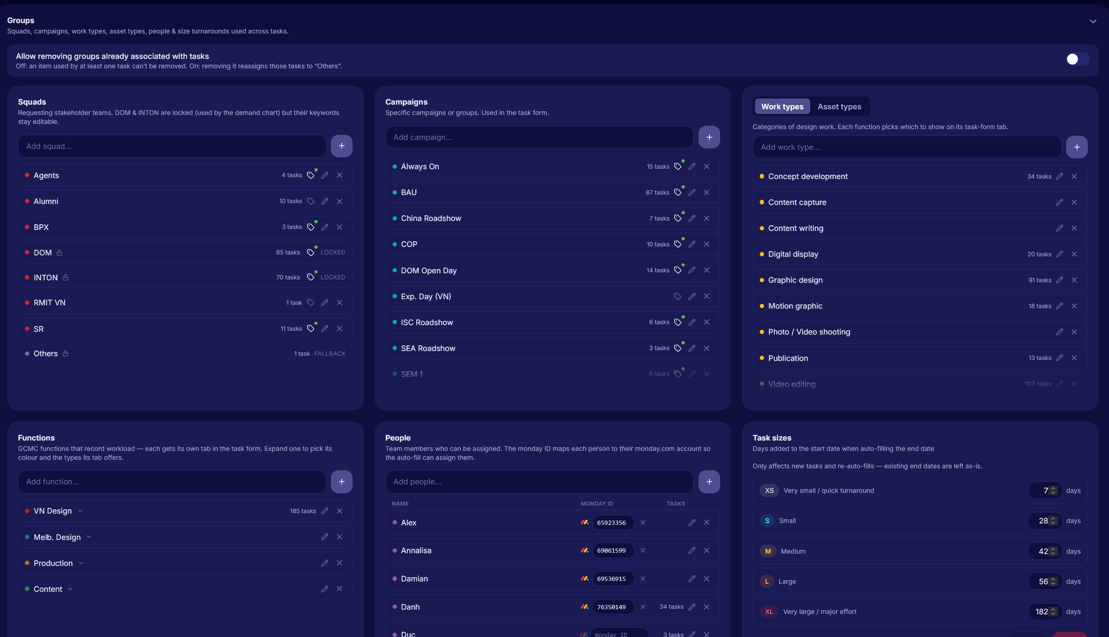
Setting page
Where GCMC customises the app to match how the team actually works — the lists, functions and defaults everything else in the app draws from.

Slide 13
GCMC Workload report
Add / migration guide

Slide 14
Preparation
Go through the setting to see how each group is defined. This includes
Squads — the stakeholder teams requesting work (DOM, INTON, Alumni, etc.)
Campaigns — the named campaigns or initiatives tasks are logged against
Work Types — the kinds of work performed (Graphic design, Video editing, Articles writing etc.)
Asset Types — the kinds of deliverables produced (Statics, Display ads, Articles, etc.)
Functions — the four GCMC teams that record workload (Vietnam Design, Melbourne Design, Production, Content), each with its own colour and task-form tab
People — the team roster tasks get assigned to
Task sizes — XS–XL, each with a default turnaround used to auto-fill new tasks' end dates

Slide 15
Important notes
Watch for duplicates.
Check existing items carefully before adding a new one — it's easy to accidentally create two entries for the same thing (e.g. "DOM" and "Domestic"). Duplicates split the data and quietly break the dashboard's numbers.
Work / Asset types — agree on a shared definition.
This is the one that matters most: every team needs to define "a unit of work" or "an asset" the same way, or add a new one that makes sense
Refer to VN Design's existing types (and their tasks) as a reference point before inventing new ones. Keep categories broad — things like "Paragraphs," "Lines," "Minutes of shooting," or "Photos taken" are too granular; stick to categories the whole team can count consistently.
Be careful renaming/removing items in use
Each item shows its task count — treat that as a warning sign. Renaming is usually fine (it rewrites every task that uses it), but removing something with tasks attached will reassign those tasks to "Others."

Slide 16
Important notes
People — the roster is already populated, add more as needed.
Functions — add/remove as your team structure changes
Nothing on the dashboard uses this yet, but it's reserved for future team-level reporting. Fill in the monday.com user ID where you have it — that's what lets the monday auto-fill assign people automatically when it matches a task.
(e.g. a new "Media" function). This only controls what shows up on that function's tab in the task form — it's purely for keeping the form uncluttered, and doesn't touch any task that's already been recorded.
Note: Vietnam Design and Melbourne Design stay as separate functions, but can be grouped together as "Design" when viewing the dashboard.
Task sizes — controls the auto-filled end date.
When a size (XS–XL) is picked, the app adds that size's duration to the start date to suggest an end date. The current durations mirror GCMC's existing T-shirt sizing definitions.

Slide 17
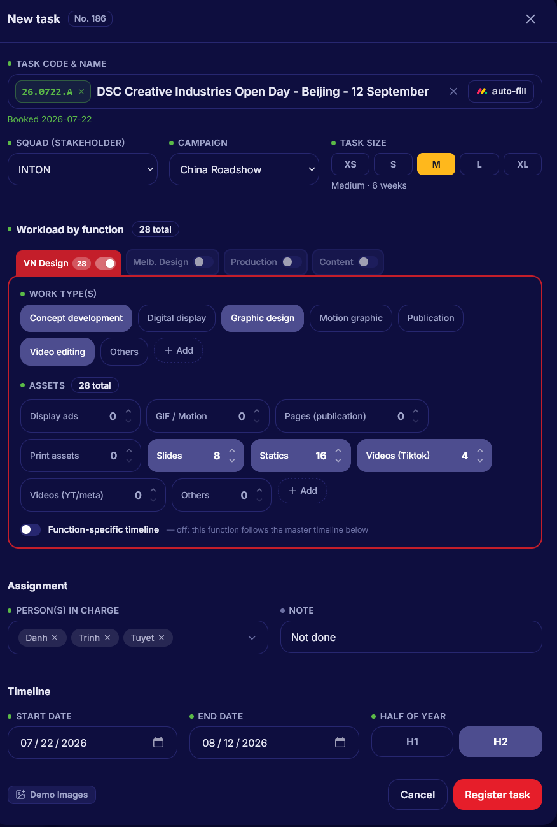


5. Function tabs
Enable whichever functions are contributing — each gets its own tab for work types and asset counts, and more than one can log against the same task. Add a new type if it's genuinely missing, but think twice first. Big campaigns can have all four functions enabled at once.
Function-specific timeline: leave this off for now — the dashboard doesn't use it yet. Timeline stays task-level (one shared start/end for the whole task).
6. Person in charge
Check and add as needed — auto-fills from monday.com if that person's name and monday ID are set up in Settings.
7. Start / end dates & half of year
Start date is auto-filled from a valid code or monday's Timeline column.
End date is auto-filled from
T shirt size (or from monday, if available) — override either manually if needed. Half of year
auto-fills too, based on the end date.
8. Register
Once required fields are filled, click Register task — it saves straight to the database and the dashboard updates live, no refresh needed.
Add new task
1. Task code & name
Paste the exact task name from monday.com, code included — the app detects the code and formats it automatically. If that code's already registered, you'll be prompted to edit the existing task instead of creating a duplicate. Codes are optional; they're a VN Design convention only.
2. monday.com auto-fill
(2025-26 only). Click the button to search monday.com. Pick a result from the dropdown and it auto-fills:
T-shirt size
Person in charge
Start and end dates (not always available)
3. Squad & campaign
Fill these in — certain keywords in the task name can trigger auto-fill.
4. Task size
Check it if auto-fill didn't already set it.

Slide 18
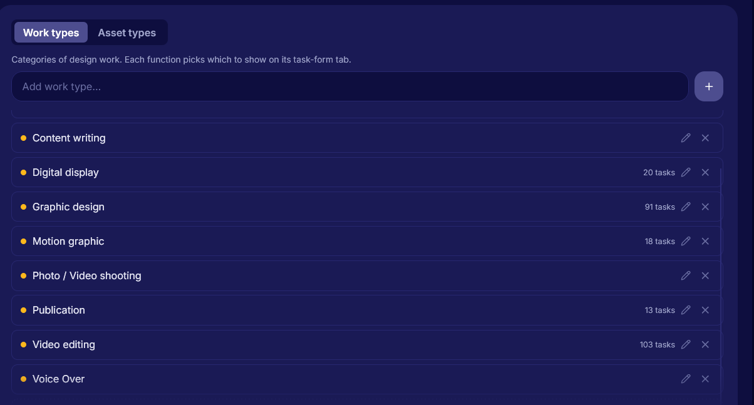
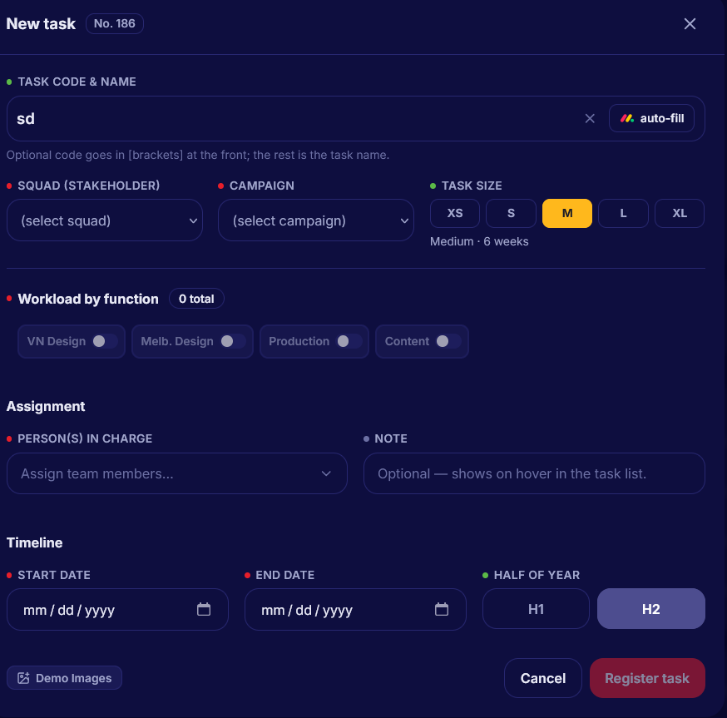
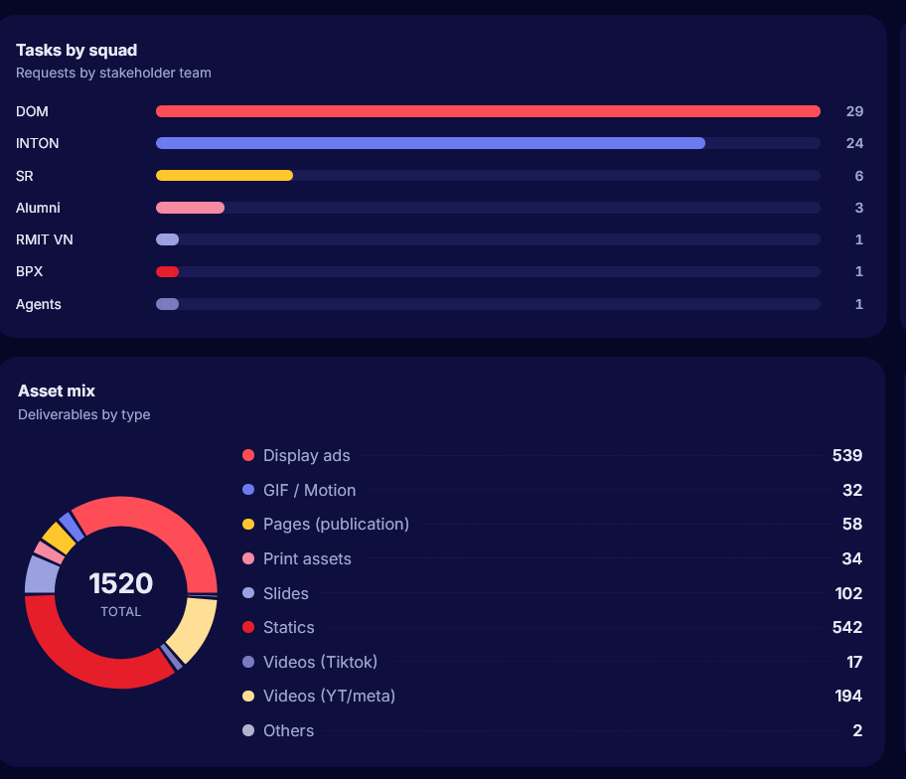
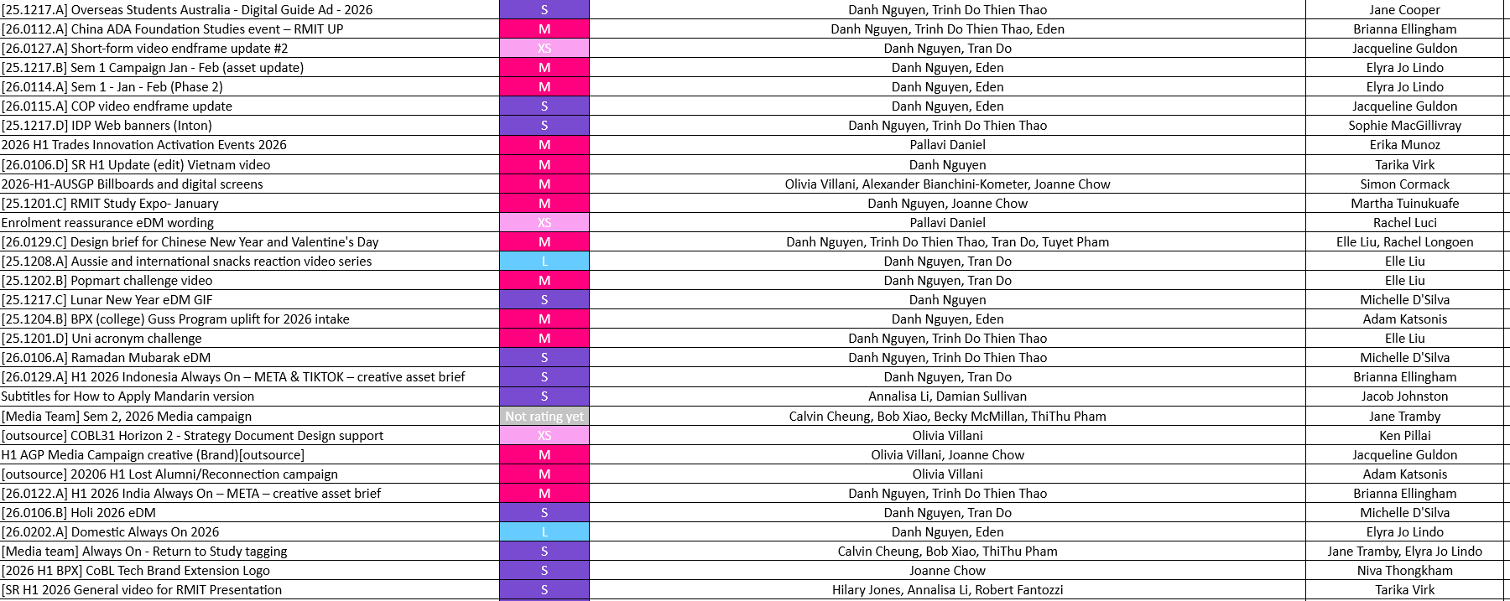
Recommended Migration process
1
Review and define your functions’s work types
2
Track progress and data with a task sheet
Fill and review live
changes
3
Before migrating anything, go into Settings and check what work/asset types your function will use. Reuse VN Design's existing definitions where they fit — only add new ones where your function genuinely needs a type that doesn't exist yet.
Export your team's annual task list from monday.com and use it as your migration tracker — one row per task, checked off as it's added to the app.
Many tasks are already multi-function collabs and exist in the system from another team's entry; for those, you don't need to re-create the task — just search for the task, add your function's tab with its own work types and asset counts.
Enter tasks into the app using the tracker as your checklist. Since the dashboard updates live, review it as you go — a quick sense-check that squads, campaigns and asset counts are landing where you'd expect catches mistakes early, before the whole team's history is migrated.

